Slide 1
Factory Production Optimization
Group 4: Prashanti Bijapur, Shrutanvi Datar, Huixin Li, Vrinda Sehgal, Roshni Victor

Slide 2
Company Overview & Project Statement
Company Overview:
In the heart of an industrial town, a bustling factory stands as a hub of productivity and innovation. This factory specializes in manufacturing seven distinct products, each designed to meet specific customer needs. These seven products are brought to life through the combined efforts of five types of machines within the factory.
The profit of each product per unit sold are included in the table below:
Project Statement:
The problem at hand is to determine the optimal production and maintenance plans for a factory that manufactures seven different products using various machines. The goal is to maximize the profit while satisfying the constraints on machine maintenance, product sales limitations, and inventory requirements.
 | Glassware | Home Decor | Plumbing | Automotive | Kitchen Appliances | Electronics | Furniture
Profit | $10 | $6 | $8 | $4 | $11 | $9 | $3
Notes:
Prashanti

Slide 3
Factory Machines Overview
02
Vertical Drill (2)
01
2 Vertical Drills
Downtime - 1 month in 6 months
Grinder (4)
02
4 Grinders
Downtime:
  2 - 1 month in 6 months
  2 - No downtime
01
04
05
Borer (1)
04
1 Borer
Downtime - 1 month in 6 months
03
Horizontal Drill (3)
05
03
3 Horizontal Drills
Downtime - 1 month in 6 months
Planer (1)
1 Planner
Downtime - 1 month in 6 months
Notes:
Prashanti

Slide 4
Production Time Requirement (in hours)
Machines
Products
 | Glassware | Home Decor | Plumbing | Automotive | Kitchen Appliances | Electronics | Furniture
Grinder | 0.5 | 0.7 | / | / | 0.3 | 0.2 | 0.5
Vertical Drill | 0.1 | 0.2 | / | 0.3 | / | 0.6 | /
Horizontal Drill | 0.2 | / | 0.8 | / | / | / | 0.6
Borer | 0.05 | 0.03 | / | 0.07 | 0.1 | / | 0.08
Planner | / | / | 0.01 | / | 0.05 | / | 0.05
Notes:
Roshni

Slide 5
Maximum Products Sold
Products
Months | Glassware | Home Decor | Plumbing | Automotive | Kitchen Appliances | Electronics | Furniture
January | 500 | 1000 | 300 | 300 | 800 | 200 | 100
February | 600 | 500 | 200 | 0 | 400 | 300 | 150
March | 300 | 600 | 0 | 0 | 500 | 400 | 100
April | 200 | 300 | 400 | 500 | 200 | 0 | 100
May | 0 | 100 | 500 | 100 | 1000 | 300 | 0
June | 500 | 500 | 100 | 300 | 1100 | 500 | 60
Notes:
Roshni

Slide 6
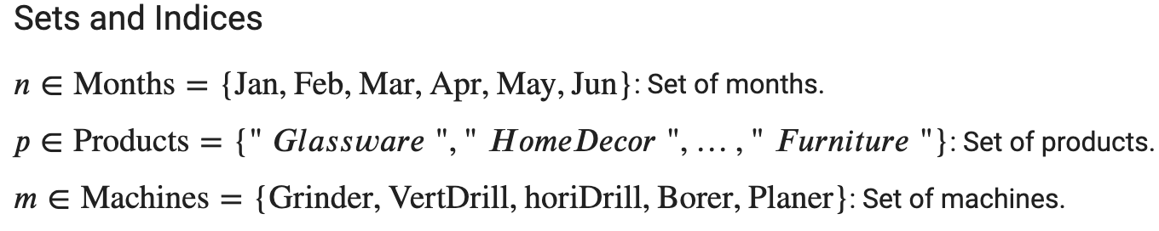
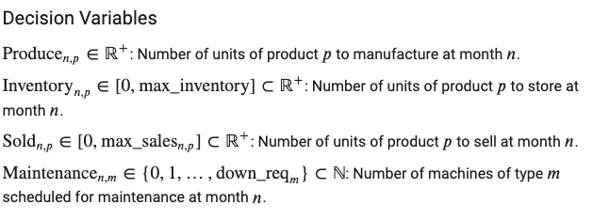
Decision Variables
Notes:
Huixin
For sets and indices, we declared n as month, and p as products, last one m represents machines.
Before formulating the objective function, we firstly defined 4 decision variables.
Produce means number of units of A product to produce at a certain month
Inventory means number of units of A product stored as inventory at certain month.
Sold means number of units of A product to sell at a certain month.
And last one maintenance means number of A type of machine scheduled for maintenance at a certain month.
As we mentioned earlier in the machine overview that each machine has specific downtime requirement and we wrap it as a dictionary mapping value to key.
Because of the nature of our decision variables can’t be decimal numbers, so we choose ILP model to solve our project.

Slide 7

Objective Function
Complexity consideration:
Overall profit is related to not only inventory expense but also other underlying factors.
  Optimal downtime plan for 5 machines.
  Sell plan to make sure continuous profitability
  Inventory plan to assure the factory has sufficient products to sell even under machines downtime.
Notes:
Huixin
As we learnt from project overview the goal is to maximize profit. And we formulated the objective function accordingly. The above function means Sum of profit achieved from each product in all 6 month minus sum of inventory expense for each product in all 6 month.
At first glance, you may say it’s a straightforward formula, but when we zoom in to details, it is a very complex project because the overall profit is not only related to inventory expense but also other underlying factors.
Optimal downtime plan for 5 machines.
Sell plan to make sure the factory can have consistent profitability
Inventory plan is required to assure the factory has sufficient products to sell even under machines downtime.
My teammates will cover detailed factors in our analysis part. Now I’ll handover to Shrutanvi.

Slide 8
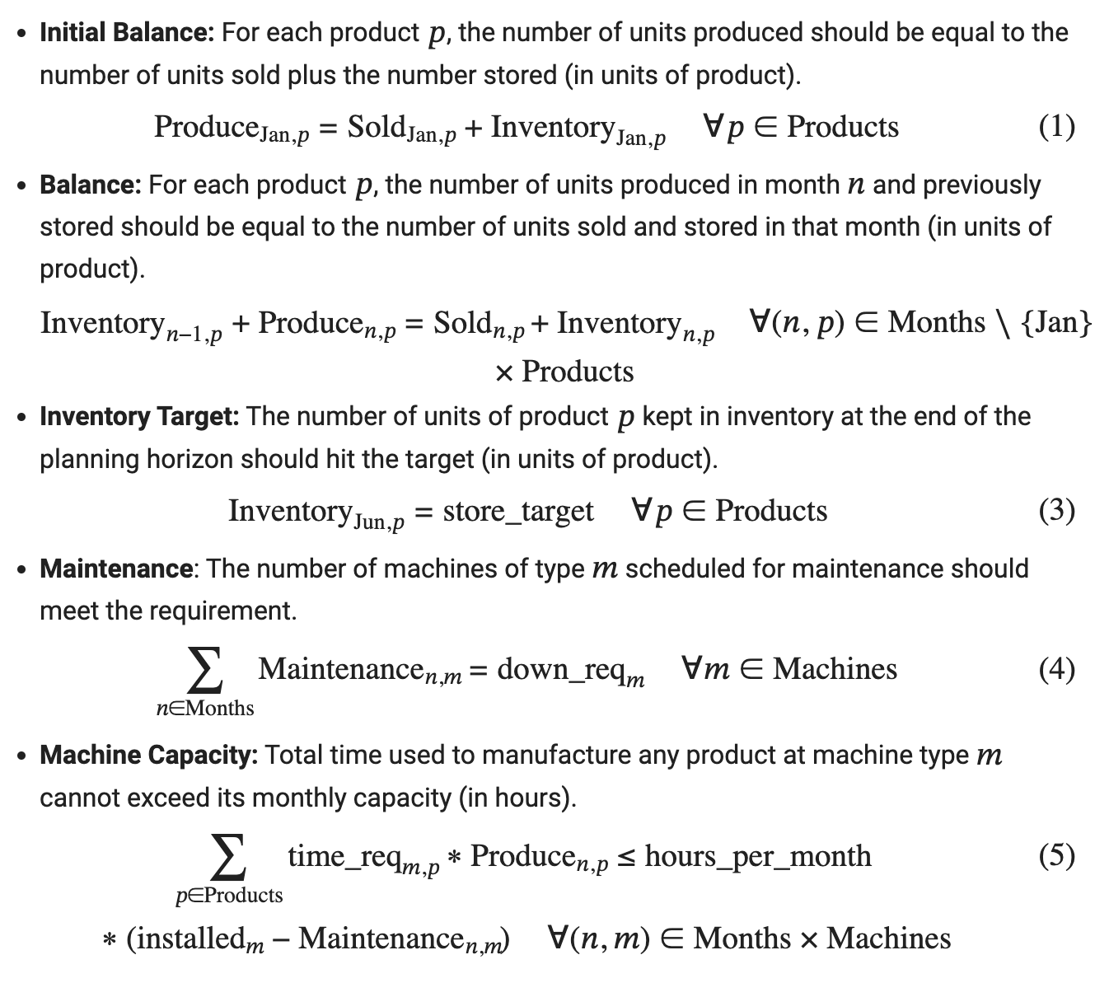
Constraints
Notes:
Shrutanvi

Slide 9
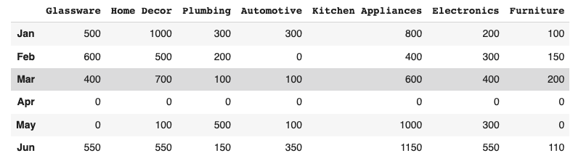
Optimal Solution
Optimal Result: The result of the optimization model shows that the maximum profit we can achieve is $108,855.00
Notes:
Shrutanvi

Slide 10
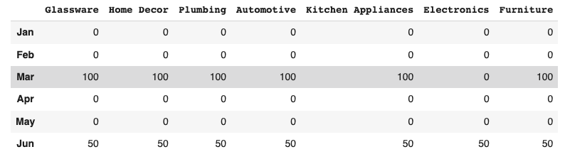
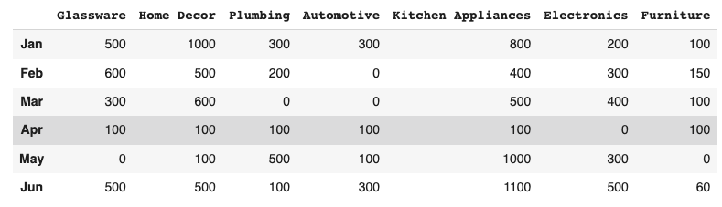
Project Summary
Production plan
Inventory plan
Sales plan
Notes:
Vrinda

Slide 11
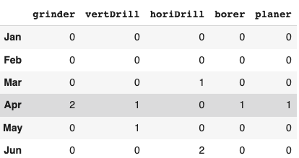
Project Summary
Maintenance plan
Production plan
Notes:
Vrinda

Slide 12
Project Summary
Production plan
Sales plan
Notes:
Vrinda

Slide 13
Thank you!
Any Questions?

